Slide 1


Expanding the Conductor’s Palate: The Laban “Efforts” as a Tool for Expressive Gestural Communication
Chris Albanese, DMA
Associate Professor of Choral Conducting
Indiana University Jacobs School of Music
Director, The Singing Hoosiers

Slide 2
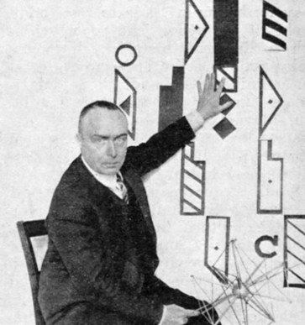
Rudolf von Laban (1879-1958)
Austro-Hungarian choreographer and dance theorist
Pioneering influence in the field of modern and expressionist dance
Movement analysis
Labanotaion (movement notation system)

Slide 3
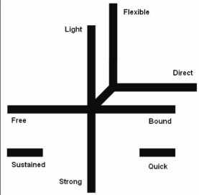
Labaonation and the “Elements”
Used in dance, theater, and other non-artistic disciplines
Identifies the dynamic quality of movement by categorizing it within the context of four elements
4 Elements: Space, Weight, Time Flow

Slide 4
Context and Application for Conductors
Applicable for conductors + singers (class and rehearsal)
Creating a shared gestural vocabulary (“efforts”)
Realizing one’s sonic vision through movement/gesture
Choosing appropriate rehearsal syllables

Slide 5
The Four Elements
Space | Weight | Time | Flow
Manner in which energy is focused | Force exerted in a movement | Expenditure, duration of a movement | The quality of bodily tension
Direct vs. Indirect | Light vs. Heavy | Quick vs. Sustained | Free vs. Bound

Slide 6
Efforts: Elements in combination
EFFORT | Space | Weight | Time
Float | Indirect | Light | Sustained
Wring | Sustained | Heavy | Indirect
Glide | Sustained | Light | Direct
Press | Sustained | Heavy | Direct
Flick | Quick | Light | Indirect
Slash | Quick | Heavy | Indirect
Dab | Quick | Light | Direct
Punch | Quick | Heavy | Direct

Slide 7
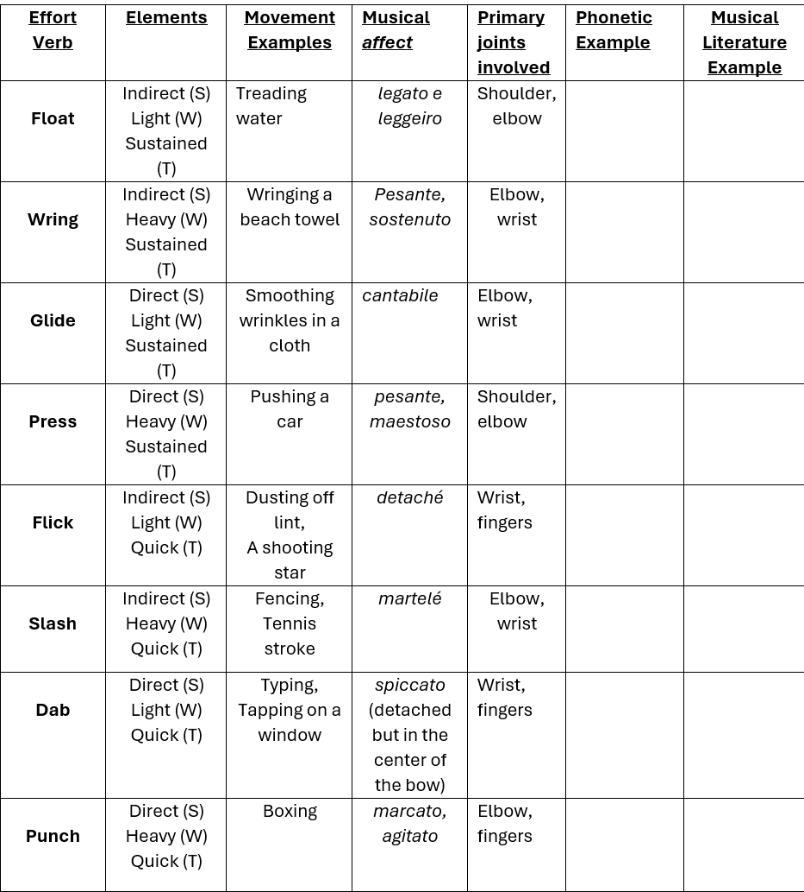

Slide 8
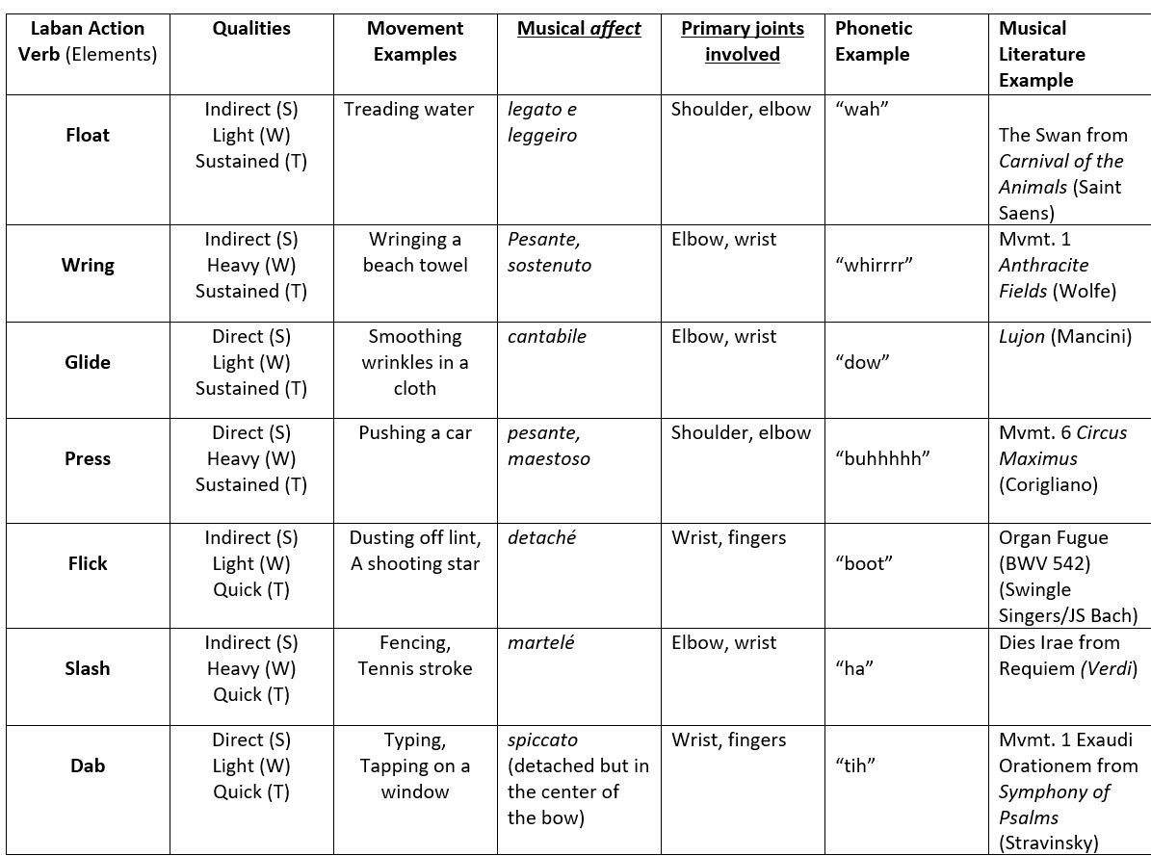

Slide 9
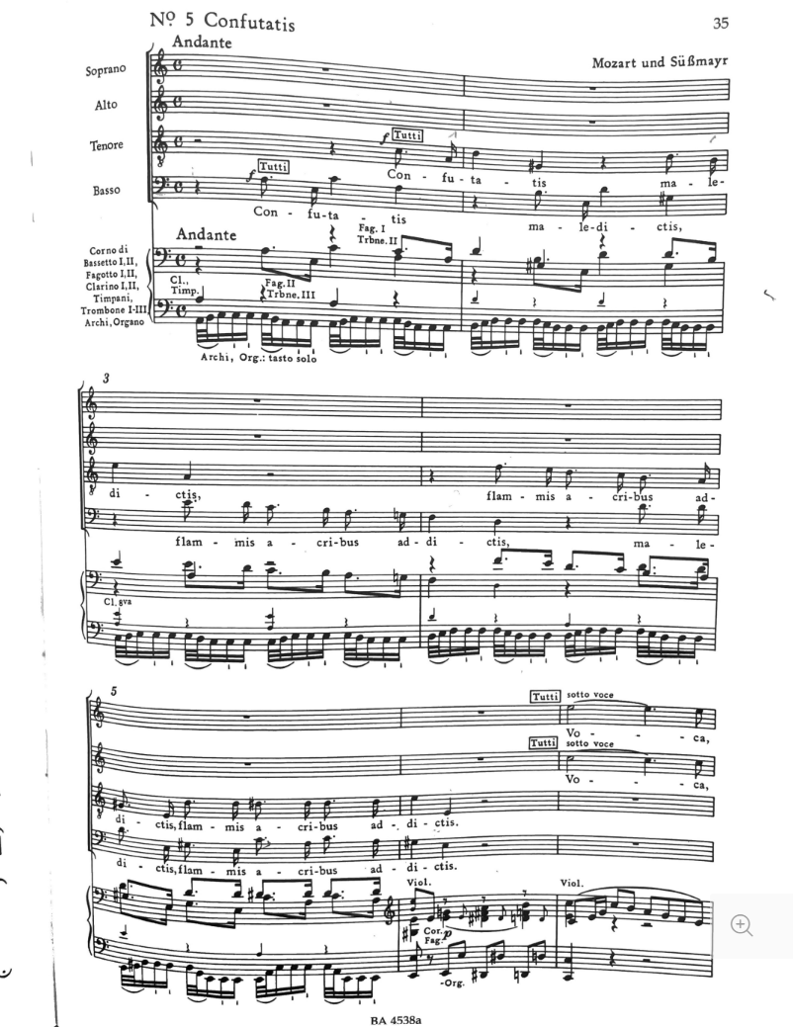

Slide 10
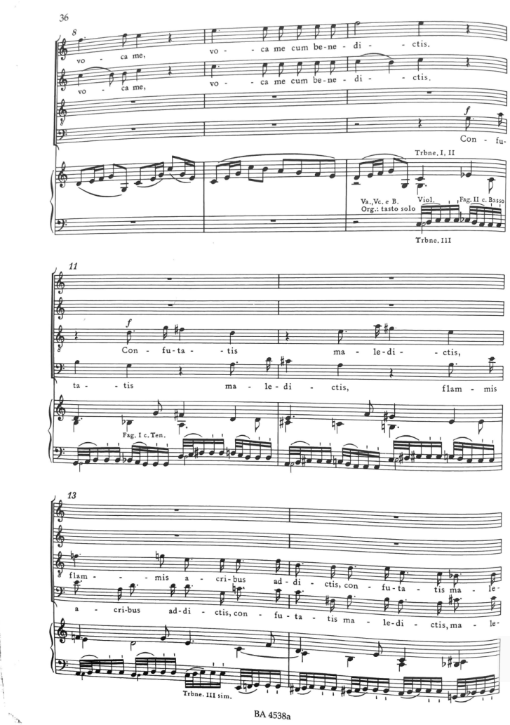

Slide 11

How to reach me
Chris Albanese
calbanes@iu.edu

