Slide 1
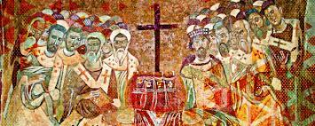
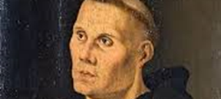
What Do Lutherans Have to Offer?
An Ecumenical Conversation at the 1700th Anniversary of Nicaea
Joel Elowsky
Concordia Seminary
St. Louis, MO

Slide 2
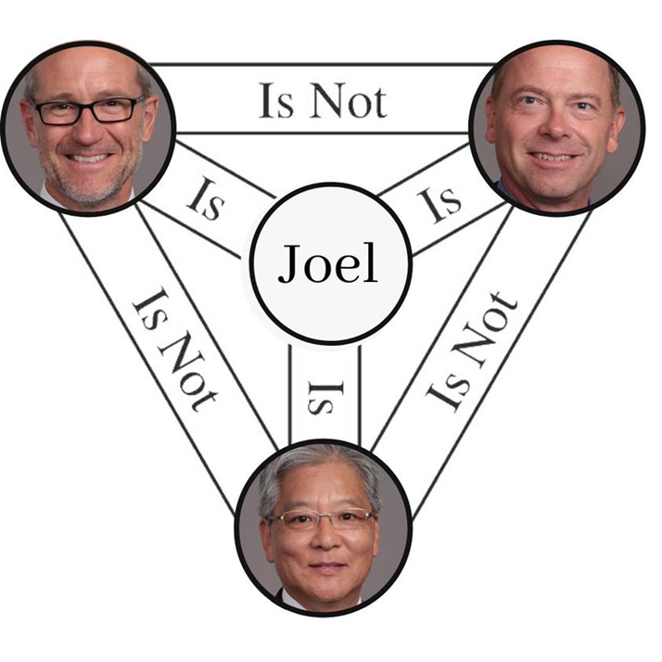
The Joelity is not Nicene

Slide 3

Outline of Paper
Part One: Nicaea, Arius, Begotten and Homoousios
Part Two: The Lutheran Reception of the Nicene Council and Its Creed, Then and Now

Slide 4
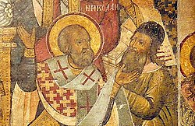
A Different Take on Arius’ Thalia
There once was a man named Arius
What he said was truly nefarious
He said God is One
But excluded His Son
Which is really quite precarious
So Nicaea judged him deleterious

Slide 5
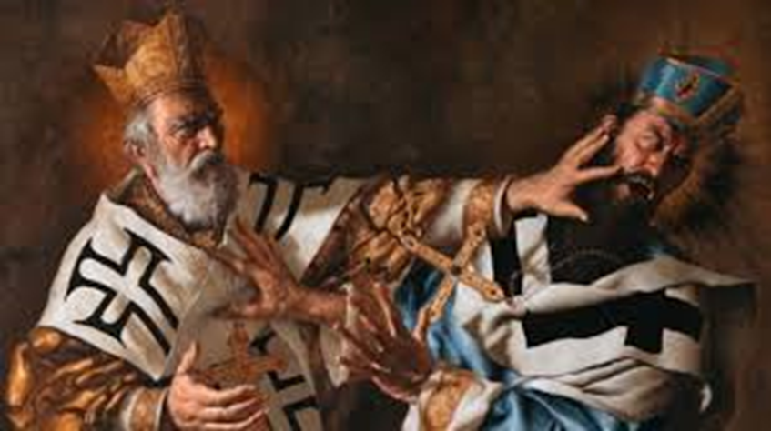
The Church’s Response to Arius
A 1700 year old creed that is still relevant
The Role of the Holy Spirit

Slide 6
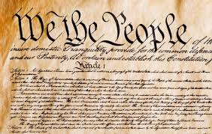
Confessing the Creed
An analogy – The Creed and the Constitution
Original text does not change – much
The role of amendments and their rarity
What do you call someone who changes the creed on their own?

Slide 7
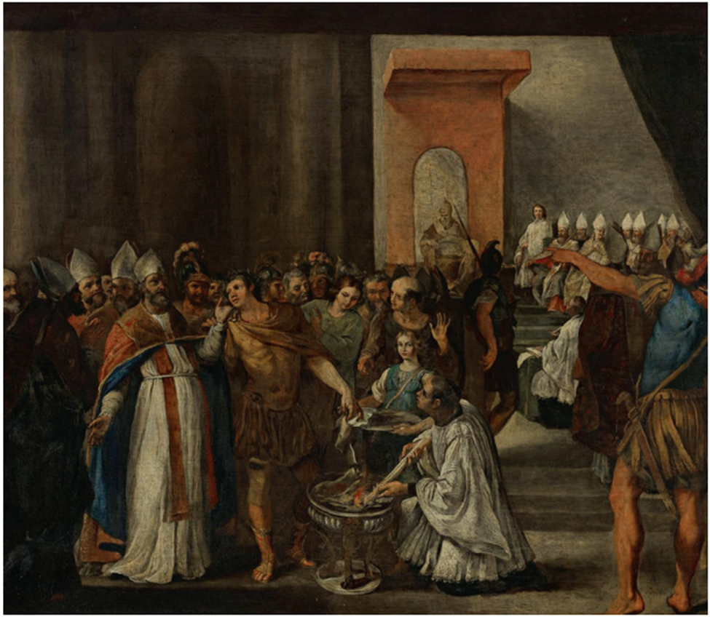
Was Nicaea just an argument over words?
Yes and no
Two key terms up for debate
  Begotten (ginomai/gennao)
  Substance/Essence/
  (ousia)

Slide 8
Arius’ creed
We acknowledge one God, only unbegotten, only eternal, the only one without cause or beginning . . . the begetter of his only begotten Son before endless ages; through whom also he made both the ages and all that is; begetting him not in appearance but in truth, causing him to subsist by his own will immutable and unchanging, perfect creation of God, but not as one of the creatures, a begotten being (γέννημα), but not like one among other generated things in the sense of an emanation as Valentinus taught, nor as Manichaeus explained the begetting as ‘a homoousios portion of the Father’, nor as Sabellius’ portioning out of the monad, speaking of a ‘Son-Father’, . . .

Slide 9
Arius’ creed
. . . . But, as we say, at the will of God having been created before times and before ages, and gaining life and being from the Father, his Father also gave him real existence . . . The Son was begotten by the Father outside of time [ἀχρόνως], and created and established [θεμελιωθεὶς] before the ages. He was not before he was begotten, but was begotten outside of time before all things. He alone was made to subsist by the Father. For he is not eternal, or co-eternal, or co-unbegotten/unoriginate with the Father, nor does he have his being together with the Father, as some say in regard to relations, which would introduce two unoriginated sources [ἀρχὰς].

Slide 10
Arius’ Creed
But as the Monad and beginning of all things, God thus is before all things. Therefore, also he is before the Son. . . . For he is his beginning, as his God and the one who existed before him. But if the phrases ‘from him,’ and ‘from the womb’ and ‘I came from the father and I come’ are understood by some to mean he is part of [God] as homoousios, or as a projection, then the Father is composite and divided, and changeable, and a body, according to them, and as far as they are concerned, suffers what happens to bodies, as the incorporeal God
(Athanasius, De Synodis 16. Translation is mine, translated from the Greek text of Bright, Historical Writings of St. Athanasius, pp. 260-61 https://earlychurchtexts.com/main/athanasius/arius_to_alexander.shtml; accessed 6/14/2024.

Slide 11

Arius’ creed
Arius equates begotten with being made.
Did you exist before your children?
Some of Arius’ Scripture passages
  Proverbs 8:22
  John 14:28
  Psalm 2:7 (Acts 13:33; Heb 1:5)
  Psalm 45:7
  Philippians 2:6-11
The Son is created/begotten
Is less than the Father
Was rewarded for a job well done

Slide 12
What is Arius’ problem?
Divine monergism
The will of the Father is what is responsible for all of creation as well as its redemption
Trying to counter Gnosticism and Modalism – the primary heresies of the third century
“Homoousios” has a checkered history
  Gnosticism and the “Big Bang Theory”
  Modalism and Paul of Samosata – God is one person (prosopa)

Slide 13
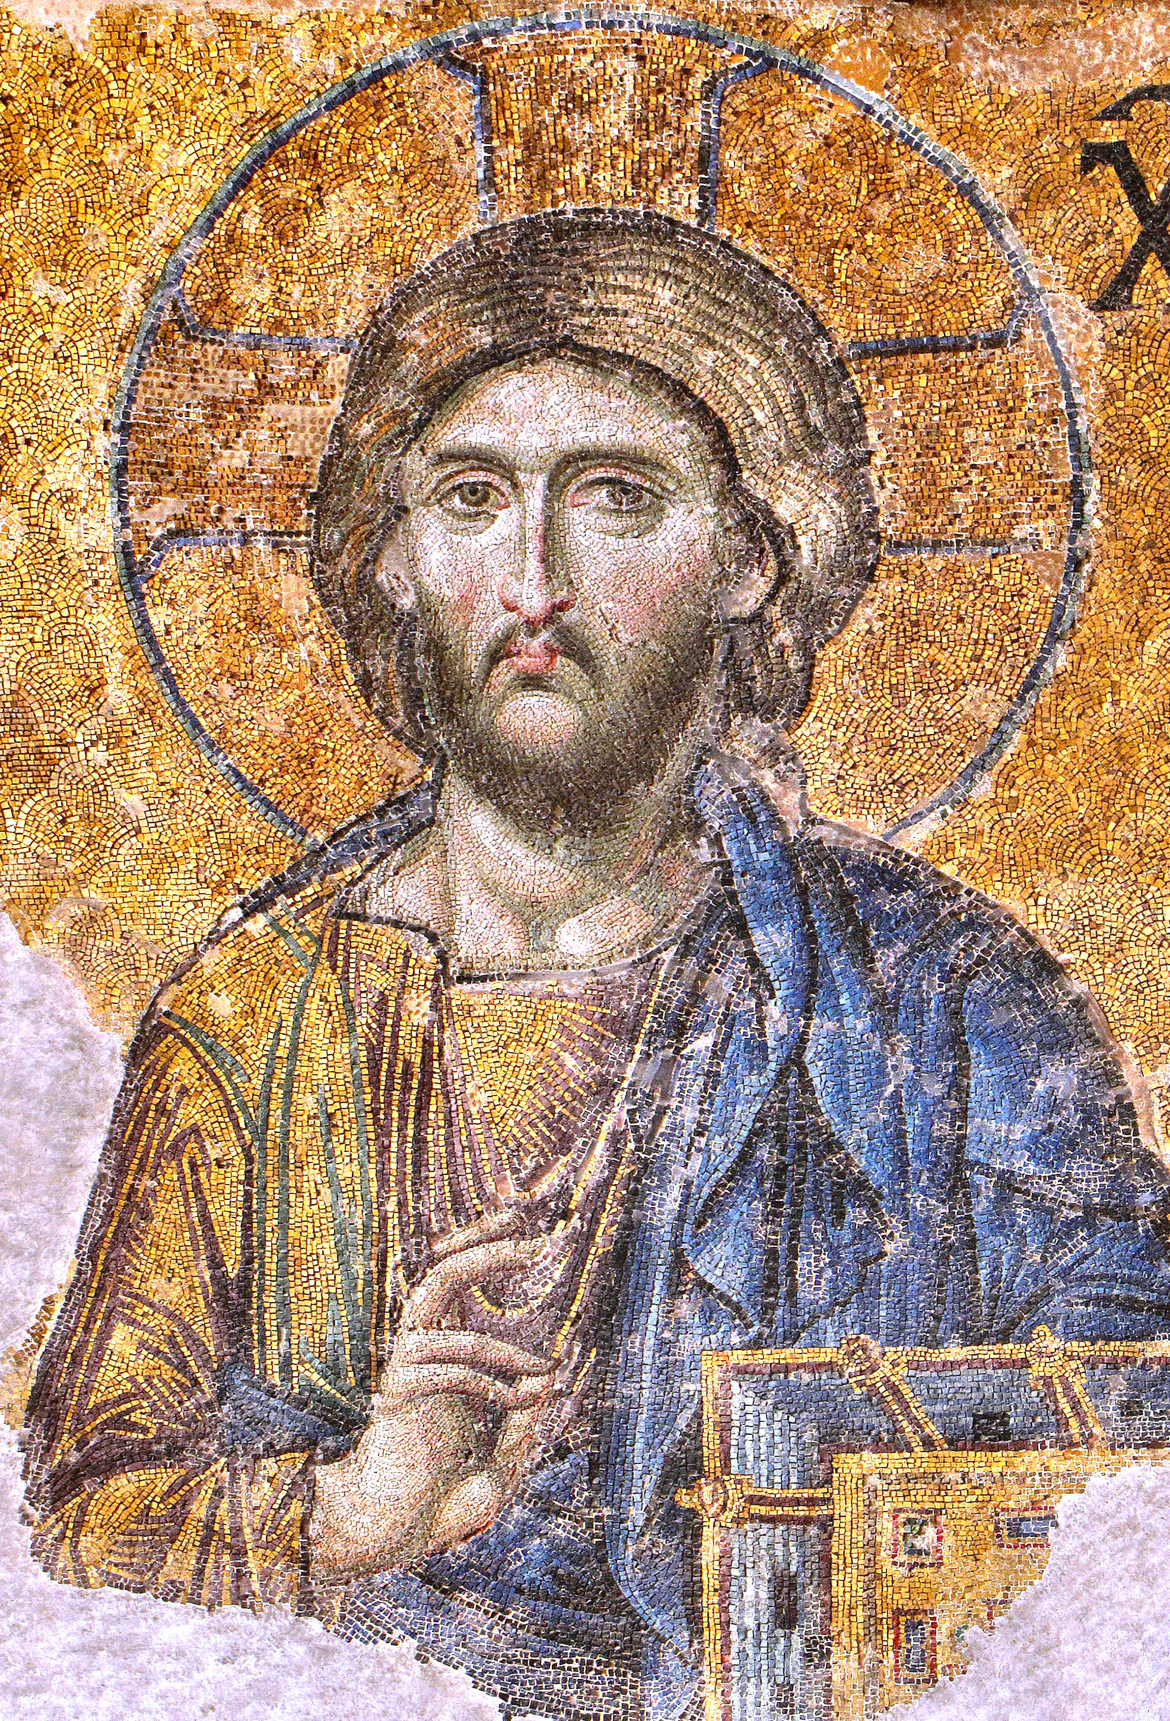
The Nicene answer
An expanded second article compared to the Apostles Creed
Centers on the Son’s relationship to the Father
  Begotten
  Homoousios
  Them there’s fightin’ words

Slide 14
The Nicene answer
one Lord Jesus Christ, the Son of God, begotten (γεννηθέντα) from the Father as only begotten (μονογενη), that is, from the essence of the Father (εκ της ουσιας του πατρος), God from God, light from light, true God from true God, begotten not made (γεννηθέντα οὐ ποιηθέντα), the same essence (ὁμοούσιον τῷ πατρί) with the Father, by whom all things came into being (εγένετο), both those in heaven and those on the earth.

Slide 15
Τhe Nicene anathemas
“Those who say, “there was when he was not” or “before he was begotten (γεννηθῇ) he was not,” or “he came into being (εγένετο) from what was not,” or argue that the Son of God is from another hypostasis (ὑποστάσεως) or substance (οὐσίας/ousia), or that he is created (κτιστὸν) or changeable (τρεπτὸν) or alterable (ἀλλοιωτὸν), these the Catholic and Apostolic Church anathematizes.”

Slide 16
The Nicene answer
one Lord Jesus Christ, the Son of God, begotten (γεννηθέντα) from the Father as only begotten (μονογενη), that is, from the essence of the Father (εκ της ουσιας του πατρος), God from God, light from light, true God from true God, begotten not made (γεννηθέντα οὐ ποιηθέντα), the same essence (ὁμοούσιον τῷ πατρί) with the Father, by whom all things came into being (εγένετο), both those in heaven and those on the earth.

Slide 17
Τhe Nicene anathemas
“Those who say, “there was when he was not” or “before he was begotten (γεννηθῇ) he was not,” or “he came into being (εγένετο) from what was not,” or argue that the Son of God is from another hypostasis (ὑποστάσεως) or substance (οὐσίας/ousia), or that he is created (κτιστὸν) or changeable (τρεπτὸν) or alterable (ἀλλοιωτὸν), these the Catholic and Apostolic Church anathematizes.”
Ultimate question: Who died for you?

Slide 18


Luther and the Lutherans with
Nicaea and Ecumenism

Slide 19
History of Luther and the Council/s
1519 - the Leipzig debate
1520 - Open Letter to the Christian Nobility
1521 – Diet of Worms and Luther’s Excommunication
1530/31 – Augsburg Confession and Apology
1536/37 – Smalkaldic League and Smalkald Articles
1539 – On the Councils of the Church
Polemical atmosphere of 1520s and 30s motivated Luther to ask for a council

Slide 20
Quia and Quatenus Subscription to Nicaea
Lutherans have a quatenus subscription to the decisions of the council itself – “in so far as . . .”
Melitian Schism
Dating of Easter
Canons
Constantine is Luther’s champion//German Princes

Slide 21
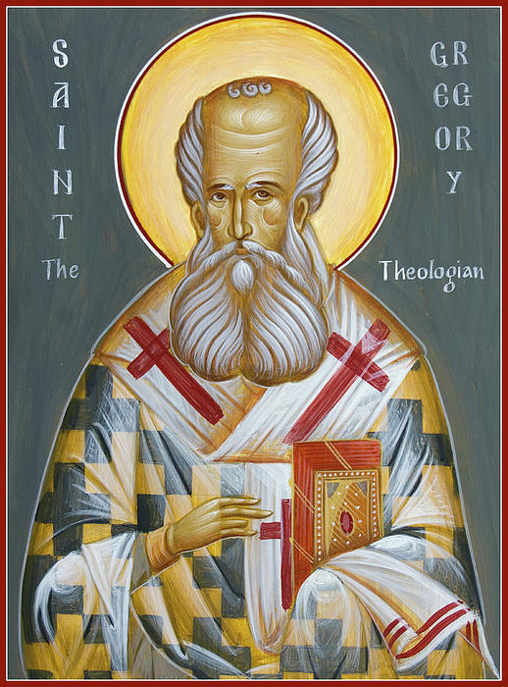
Critiquing Councils is Nothing New
Gregory of Nazianzus: “To tell the truth, I believe it advisable to flee all the councils of bishops; for I saw nothing good resulting from the councils, not even the abolition of evil, but rather sheer ambition and quarreling over precedence.” Gregory of Nazianzus, Epistle 130, To Procopius; PG 37:225-26, quoted by Luther; LW 41:120.

Slide 22
Bishops Behaving Badly
Luther: Gregory “speaks the truth when he says that the bishops are ambitious, haughty, quarrelsome, and vehement in the councils. You will find that corroborated in this council. By the same token, not all who teach correctly or uphold the true doctrine are necessarily holy. For Balaam also is a true prophet [Num. 24:16], and Judas is a true apostle [Matt. 10:4], and the Pharisees occupy the seat of moses and teach the truth [Matt. 23:2-3]. Thus we too must have something else and something more reliable for our faith than the councils. That ‘something else’ and ‘something more’ is Holy Scripture.” LW 41:120.

Slide 23
Quia Subscription to Nicaea
A quia subscription to the Creed – “because . . . .”
Lutheran ordination vows: The Nicene Creed is neither optional, nor malleable as a confession of the Lutheran faith. It is part and parcel of who we are as Lutherans.
Sola Scriptura as norma normans (the norm which norms – the rule that rules)
Creed and Confessions as norma normata (the norm which is normed – the rule that is ruled

Slide 24
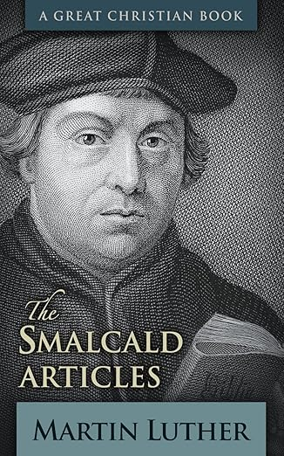
The Smalkald Articles and Nicaea
A Test Case in Ecumenism

Slide 25
Article 1 part 1
The First Part of the Articles deals with the lofty articles of the divine Majesty, namely:
That Father, son, and Holy Spirit, three distinct persons in one divine essence and nature, is on God, who created heaven and earth, etc.
That the Father was begotten by no one, the Son was begotten by the Father, and the Holy Spirit proceeds from the Father and the Son.
That neither the Father nor the Holy Spirit, but the Son, became a human being.

Slide 26
Smalkald Article 1.1 continued
4. That the Son became a human being in this way: he was conceived by the Holy Spirit without male participation and was born of the pure, holy Virgin Mary [Lat. semper virgine]. After that, he suffered, died, was buried, descended into hell, rose from the dead, ascended into heaven, is seated at the right hand of God, in the future will come to judge the living and the dead, etc., as the Apostles’ and the Athanasian creeds and the common children’s catechism teach.
These articles are not matters of dispute or conflict, for both sides confess them. Therefore, it is not necessary to deal with them at greater length now.
Luther, Smalkald Articles I; KW, 300; On Semper Virgine see BKS, 414. Emphasis mine.

Slide 27
A Footnote and an Edit
The German in the Bekenntnisshriften (BKS) has “[glauben und] bekennen, with [glauben und] in brackets.
Footnote: “Luther initially wrote ‘believe and confess,’ but then deleted the first two words because he did not trust that Catholics believed [what they were confessing].’

Slide 28
Smalkald Article 1, part two
That Jesus Christ, our God and Lord, “was handed over to death for our trespasses and was raised for our justification” [Rom 4:25]); and he alone is “the Lamb of God who takes away the sin of the world” (John 1:29). . . .
Christ’s work outlined in the Creed “may not be obtained or grasped otherwise with any work, law, or merit, it is clear and certain that this faith alone justifies us, as St. Paul says in Romans 3[28, 26]: “For we hold that a person is justified by faith apart from works prescribed by the law”; and also, “that God alone is righteous and justifies the one who has faith in Jesus. Nothing in this article can be conceded or given up, even if heaven and earth or whatever is transitory passed away.” (Luther, Smalkald Articles I.II; KW, 300-1).

Slide 29
What is God? – LC 1st Commandment
“You are to have no other gods.” “What does “to have a god’ mean, or what is God? Answer: A ‘god’ is the term for that to which we are to look for all good and in which we are to find refuge in all need. Therefore, to have a god is nothing else than to trust and believe in that one with your whole heart. As I have often said, it is the trust and faith of the heart alone that make both God and an idol. If your faith and trust are right, then your God is the true one. Conversely, where your trust is false and wrong, there you do not have the true God. For these two belong together, faith and God. Anything on which your heart relies and depends, I say, that is really your God.” (Luther, LC 1.1; KW 386)

Slide 30
Faith
Nicene Creed begins with “I believe” or “We believe”
“I believe” is fides qua – Luther’s emphasis on personal faith and trust
“We believe” is fides quae – the faith confessed – doctrinal content we have in common – something Luther also appreciated
The doctrine of the Creeds is the content of the Gospel and vice versa

Slide 31
Augsburg Confession Art. 1 and Art. 3
Article 1: “The churches among us teach with complete unanimity that the decree of the Council of Nicaea concerning the unity of the divine essence and the three persons is true and is to be believed without any doubt.” . . .
Article 3: Christ’s atoning sacrifice was a “sacrifice not only for original sin but also for all other sins and to conciliate God’s wrath [Lat.].” (KW 37-38)
In his 1528 Great Confession, Luther condemns “both the new and old Pelagians who will not admit original sin to be sin, but make it an infirmity or defect.” (Luther, Confession Concerning Christ’s Supper, LW 37:363).

Slide 32
Conclusion - Ecumenism
Lutheran Church in the Western Tradition
The LC-MS Constitution under Article III: Objectives:
The Synod, under Scripture and the Lutheran Confessions, shall—
Conserve and promote the unity of the true faith (Eph. 4:3–6; 1 Cor. 1:10), work through its official structure toward fellowship with other Christian church bodies, and provide a united defense against schism, sectarianism (Rom. 16:17), and heresy.
Handbook: Constitution, Bylaws, Articles of Incorporation: The Lutheran Church-Missouri Synod, p. 11.

Slide 33
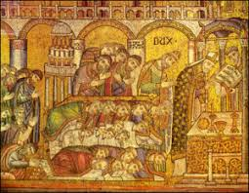
Ecumenism
We should be talking more with other churches, not less.
NALC, AELC, WLS and ELCA and other Lutheran bodies may have different concerns.

Slide 34
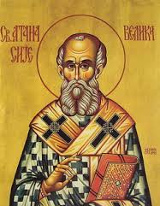
Conclusion
There once was the great Athanasius
What he said was truly bodacious:
Father and Son
Are equal as one
For your faith, that is quite advantageous
And I hope this truth is contagious

Slide 35
Further resources for study of the creed
We Believe booklets – (ICCSPress, 2025) [ICCSPress.com]
Ancient Christian Doctrine Series, 5 Volumes. Downers Grove, IL: IVP, 2009. – a patristic commentary on the Nicene Creed.
Worshiped and Glorified: A Study of the Nicene Creed
by Timothy J. Winterstein (CPH, 2025)
Jared Ortiz and Daniel Keating, The Nicene Creed: A Scriptural, Historical and Theological Commentary (Baker, 2024).
Rowan Williams, Arius (Eerdmans, 2002).

